Slide 1

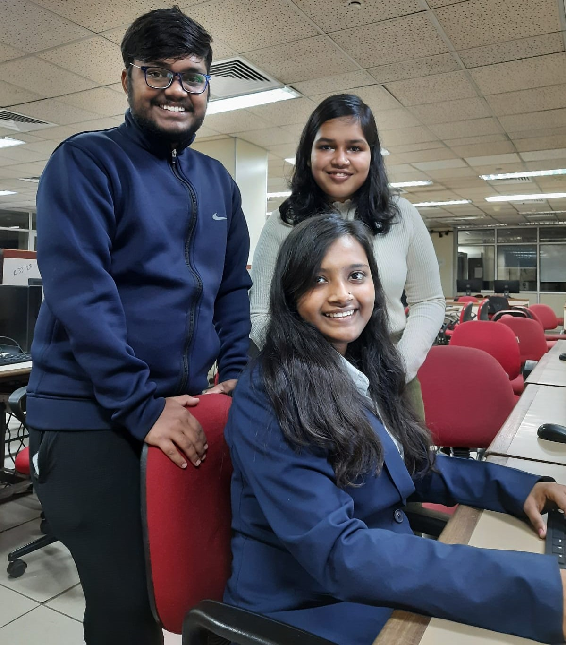
Educate Empower Enable
All India Women ONLY Start-a-thon
vaibhav@sstarsfoundation.org
+91-8619011848
Muskan, Chandrudu, Krithika, IIT Delhi (SSF)

Slide 2
About SSF
1204
40,000+
30+
Students
Students
Students
Hackathons/Start-a-thons
Scholarships
Skilling
Support Deserving underserved students to help them break the cycle of generational poverty
Inspire students to take up tech/entrepreneurship career to break the cycle of generational poverty
Empower the career advancement of recent women graduates to help them break the cycle of generational poverty
Annual family income < 3,00,000 pursuing STEM education from govt. College
Preference for First generation graduate from rural/semi-urban areas with single/no parent
Presence across 25+ states with 92%+ placement
Hackathons: Tailor-made STEM Initiatives (Ex: AIWOS, IBM Datathon AMD, Netscout, WWT, Cognizant etc.)
AIWOH - Launched and executed 2023
Start-a-thons: Maiden version 2024
Chennai Skilling Centre
Targeted technical/soft skill training alongwith internships and placement support

Slide 3
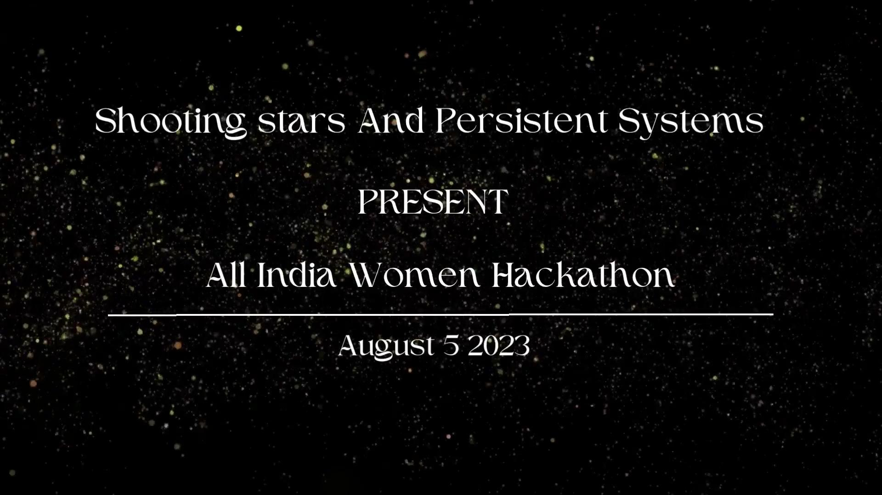
Past Success - All India Women ONLY Hackathon
Organised an All India Women ONLY Hackathon last year on 5-6th August 2023 with 8000+ registrations from over 350 cities and 750 institutes from India
The Hackathon was supported by corporates such as Persistent Systems, IBM, TCS, YES Bank, Cognizant, Paypal, Citrix (Cloud Group), Genesys etc.

Slide 4
Why All India Women ONLY Start-a-thon?
Women’s economic contribution in India accounts for 17% of the GDP, which is less than half the global average.
India currently ranks 57th out of 65 nations, in the Mastercard Index on Women Entrepreneurship (MIWE). It ranks 70th among 77 countries on the Female Entrepreneurship Index.
Women own only 20% of all enterprises in India.
82% of these women-led enterprises are micro units, run as sole proprietorships and in the informal sector.
10% to 30% of enterprises registered as women-owned are not run by women.
Only 5.9 per cent of technology based startups were founded by only females in comparison to 55.5 per cent founded by only male founders.
All India Women ONLY Start-a-thon is a Shooting Stars Foundation’s initiative to spark entrepreneurship interest in women students
Our objective with All India Women ONLY Start-a-thon is to
Instill confidence in aspiring women entrepreneurs
Give college women students access to mentorship for entrepreneurship
Connect with role models to inspire
Create a ripple effect for Women in entrepreneurship.

Slide 5
All India Women ONLY Start-a-thon
A women exclusive start-up initiative with the vision to Maximise outcome for all aspiring Women entrepreneurs of India. Feel free to share our social media post
Scale
6000+ institutes from 750+ cities of India
Reach to 1-1.25L women students. Participation: 10,000-15,000 women
Expected 1st Order Outcome
Top 50 ideas to be presented in front of 10 incubation centers and be considered for incubation
Top 25 ideas to be presented in front of top 25 Angel Investors for funding
Expected 2nd Order Outcome
15 Ideas incubated at various incubators/accelerators
15 Ideas funded via grants, angel investors OR VC funds

Slide 6
What are we doing?
Scale
6000+ institutes from 750+ cities of India
Reach to 1-1.25L women students. Participation: 10,000-15,000 women
How can we associate?
Sponsor the Start-a-thon to enable us reach maximum women across India and to efficiently run the program
Corporates can nominate volunteers for either/all the below activities (Google form)
V1: Maximise focussed Outreach (1-2 hours per day for August - September 2024)
V2: Partnerships - Enable partnerships with incubators, accelerators and angel investors to maximise outcome for the participating women (1-2 hours per day for 60 days during October - December 2024)
V3: Mentoring (3-4 hours per week during November/December 2024)
V4: Judging (3-4 hours per week during November/December 2024)
V5: Program management (3-4 hours per day during August2024 - January 2025)

Slide 7
Why sponsor?
Marketing and Branding
Leverage program reach for marketing and branding
Logo and brand presence in all email, social media communications and all press releases
1 social media awareness campaign for the brand
Encourage Gender Diversity and Build Brand Reputation
CSR (Section 135 of Companies Act 2012 - Under Schedule 7 SL#3)
Engage in impactful Corporate Social Responsibility (CSR)
Enabling outreach to Tier-2/3/4 cities of India via districtwise, citywise and statewise coordinator
Contribute to India’s Growth by Empowering Women Entrepreneurs
Livelihoods created for people with Women led organisations
All India Women ONLY Start-a-thon
Talent Acquisition
Email communication to registrants showcasing Employer brand and internship/placement opportunities
Absorb top diversity talent from across India
*Funds will be utilized for outreach, tech enablement for program management, program management, tools, logistics, prize money for winners etc. and an audited utilization certificate will be provided by Shooting Stars Foundation

Slide 8
Start-a-thon
Logistics | Mentoring, Judging & Success
Outreach to colleges across India with a focus on Tier-2/3/4 cities Engage aspiring women entrepreneurs with webinars, expert sessions, hands-on-training, panel discussions, access to role models etc. Get participants to submit ideas | Focussed Mentoring based on the start-up idea 3 rounds of - Drive Submissions, Evaluate Submissions, Shortlist, Mentor to finally reach top 50 ideas Share top ideas with incubators, accelerators, angel investors to maximise outcome for participants

Slide 9
Thank you!
vaibhav@sstarsfoundation.org
+91-8619011848

